Slide 1
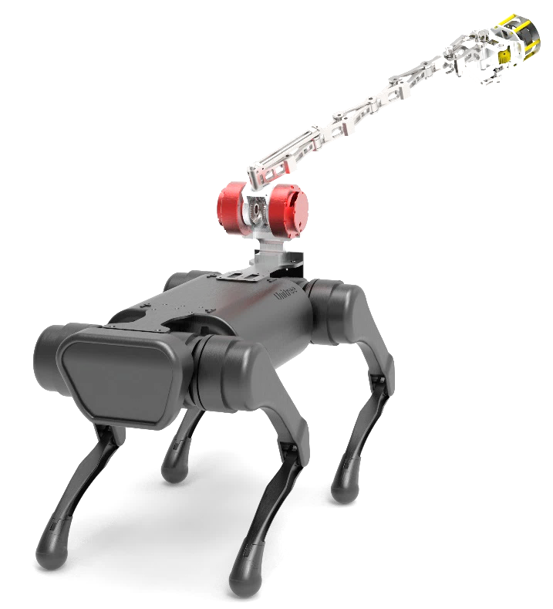
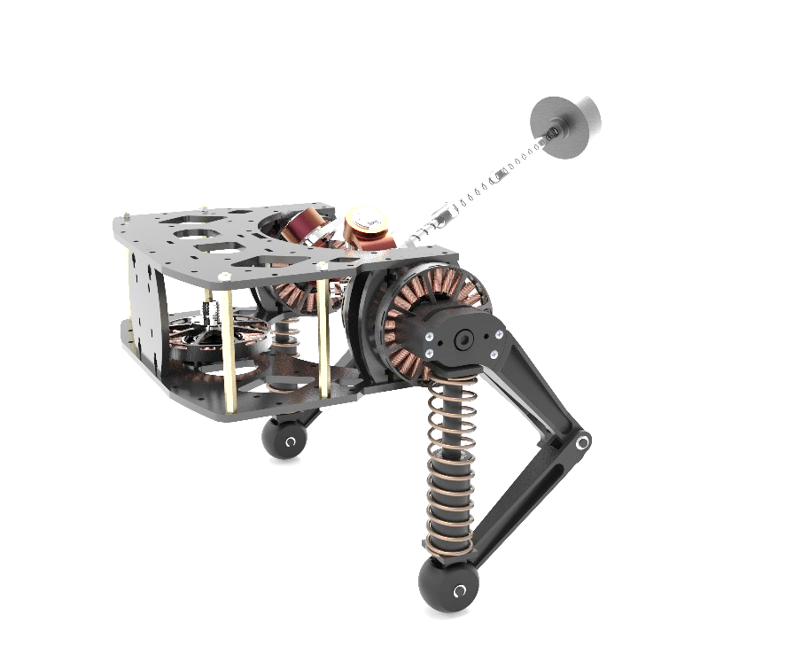
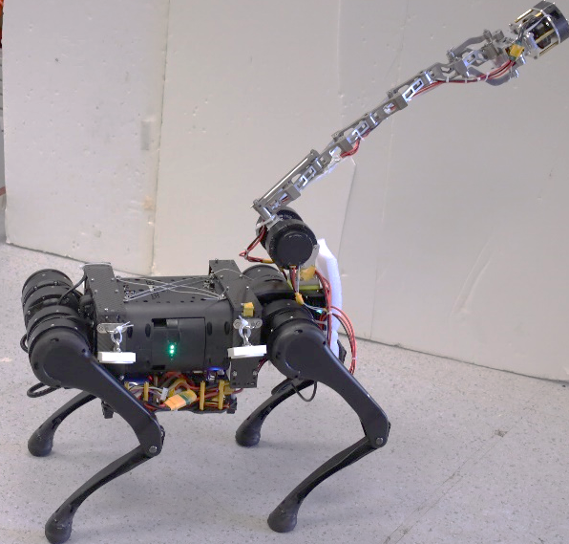
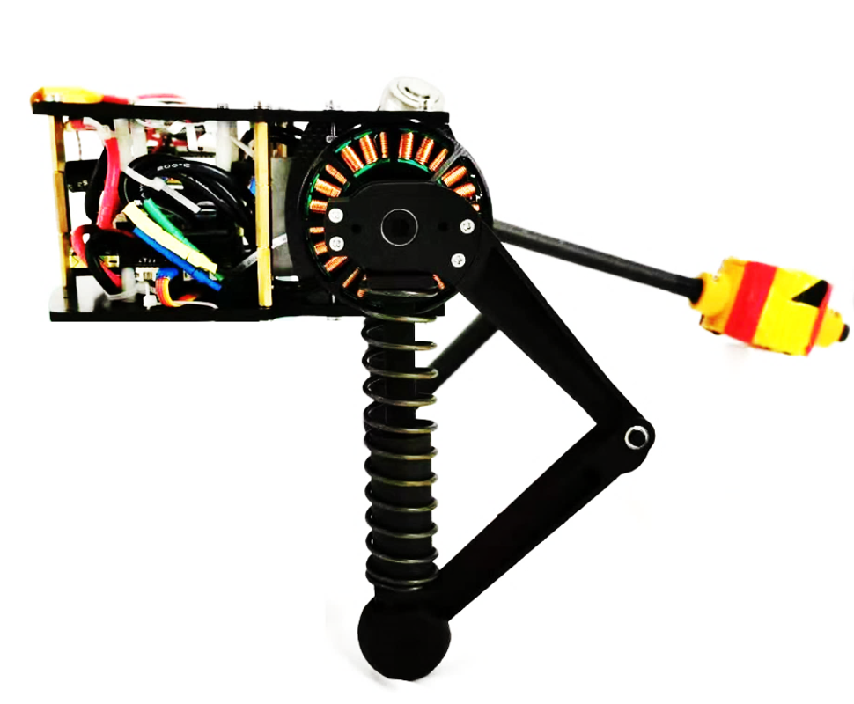

Slide 3
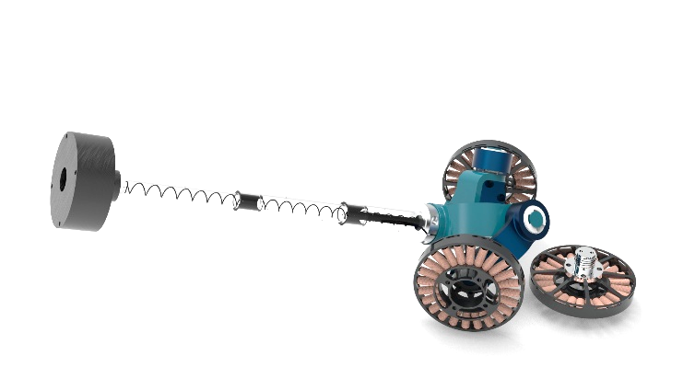
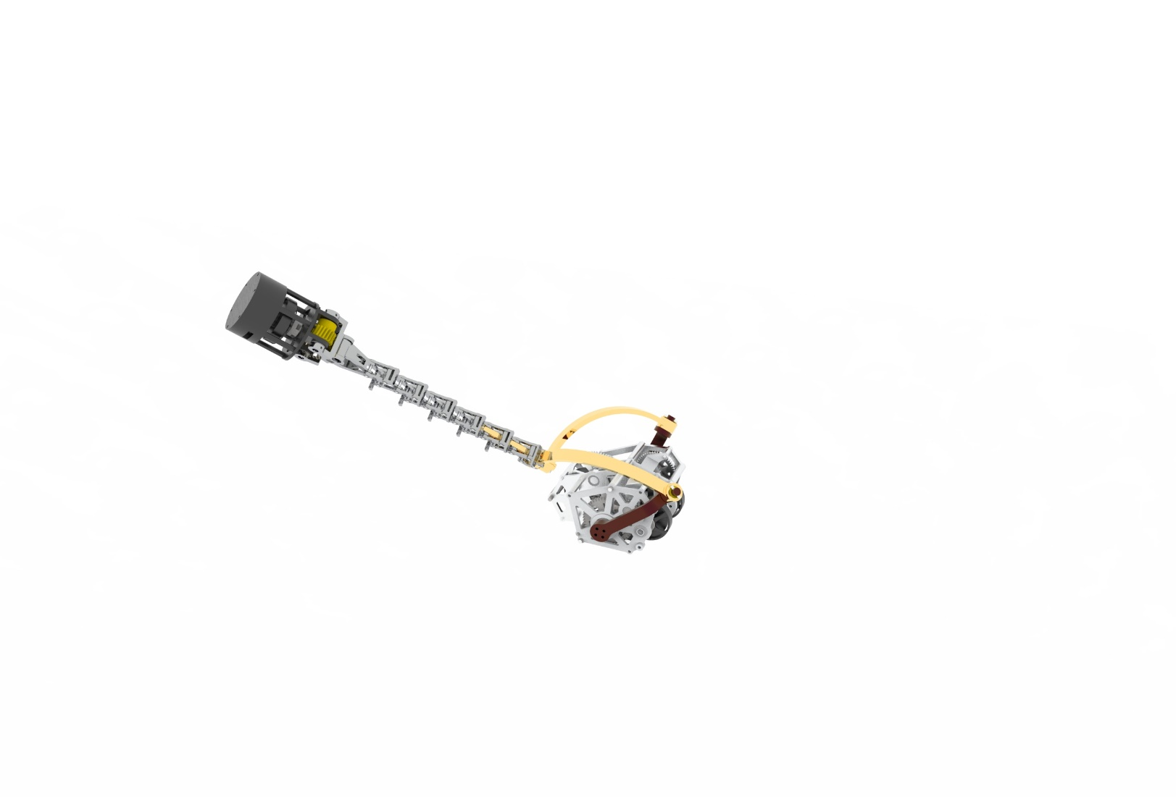
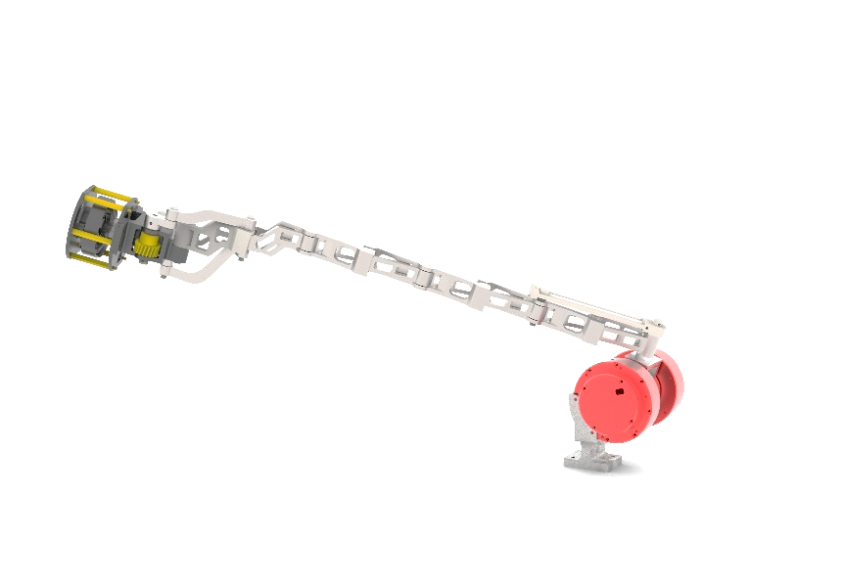
1

Slide 4
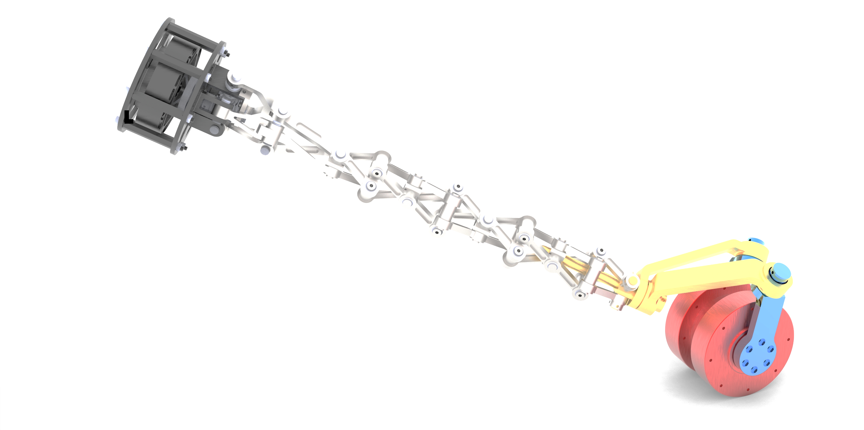
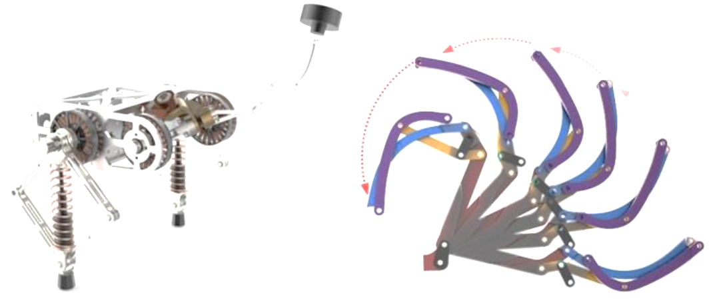

Slide 5
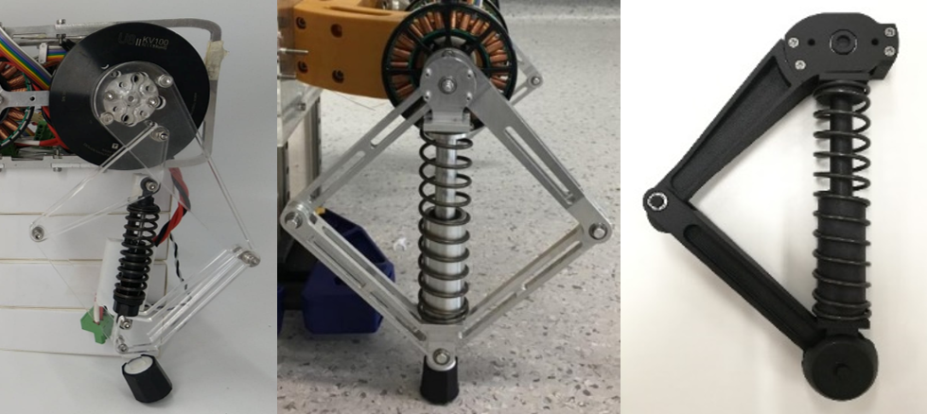
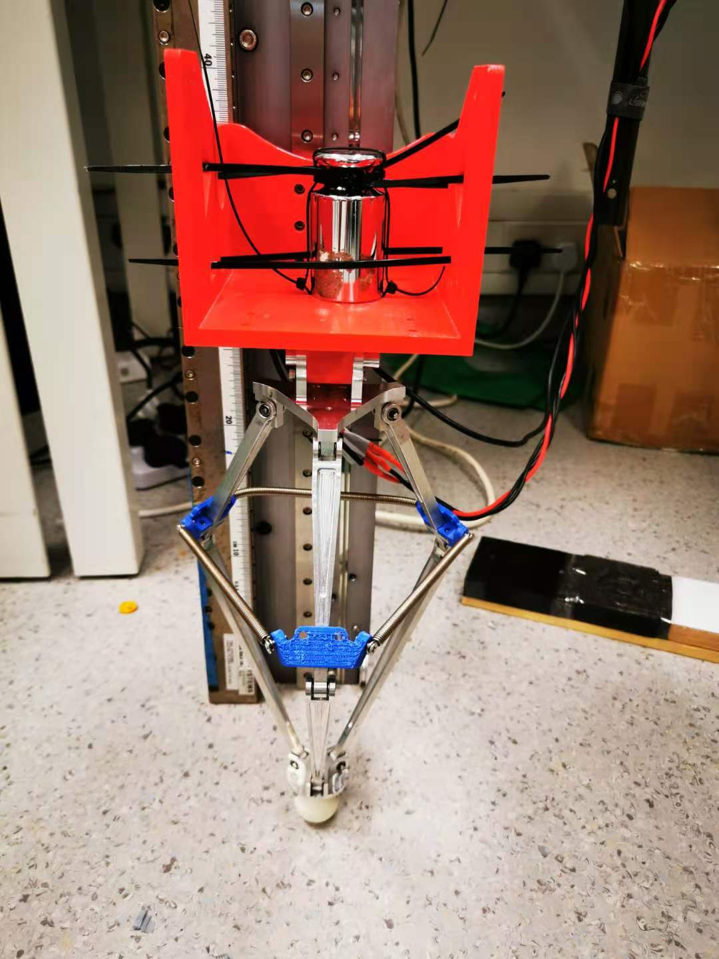
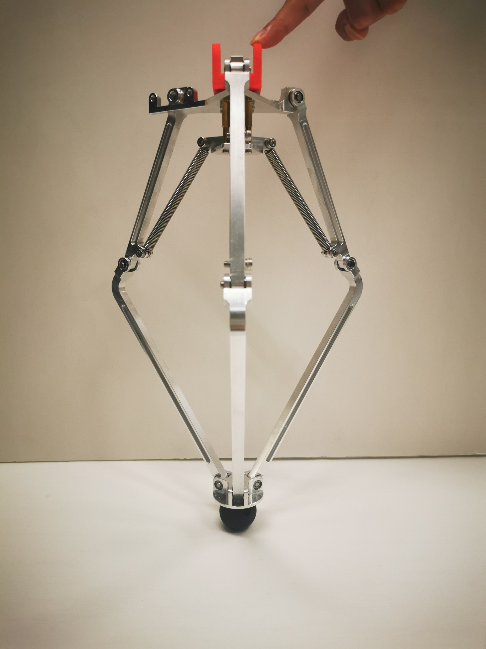
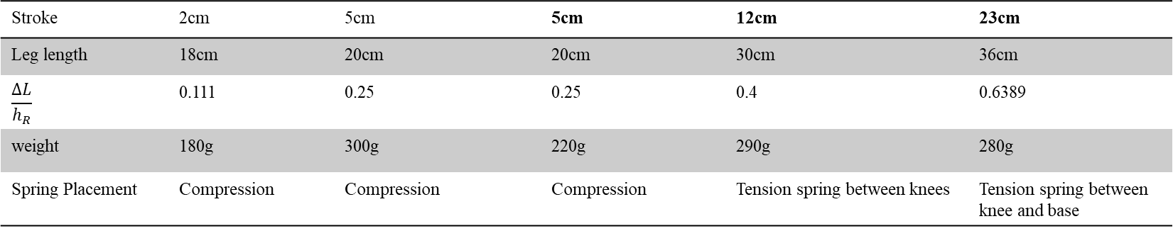
Stroke | 2cm | 5cm | 5cm | 12cm | 23cm
Leg length | 18cm | 20cm | 20cm | 30cm | 36cm
$$\frac{ΔL}{h_{R}}$$ | 0.111 | 0.25 | 0.25 | 0.4 | 0.6389
weight | 180g | 300g | 220g | 290g | 280g
Spring Placement | Compression | Compression | Compression | Tension spring between knees | Tension spring between knee and base

Slide 6
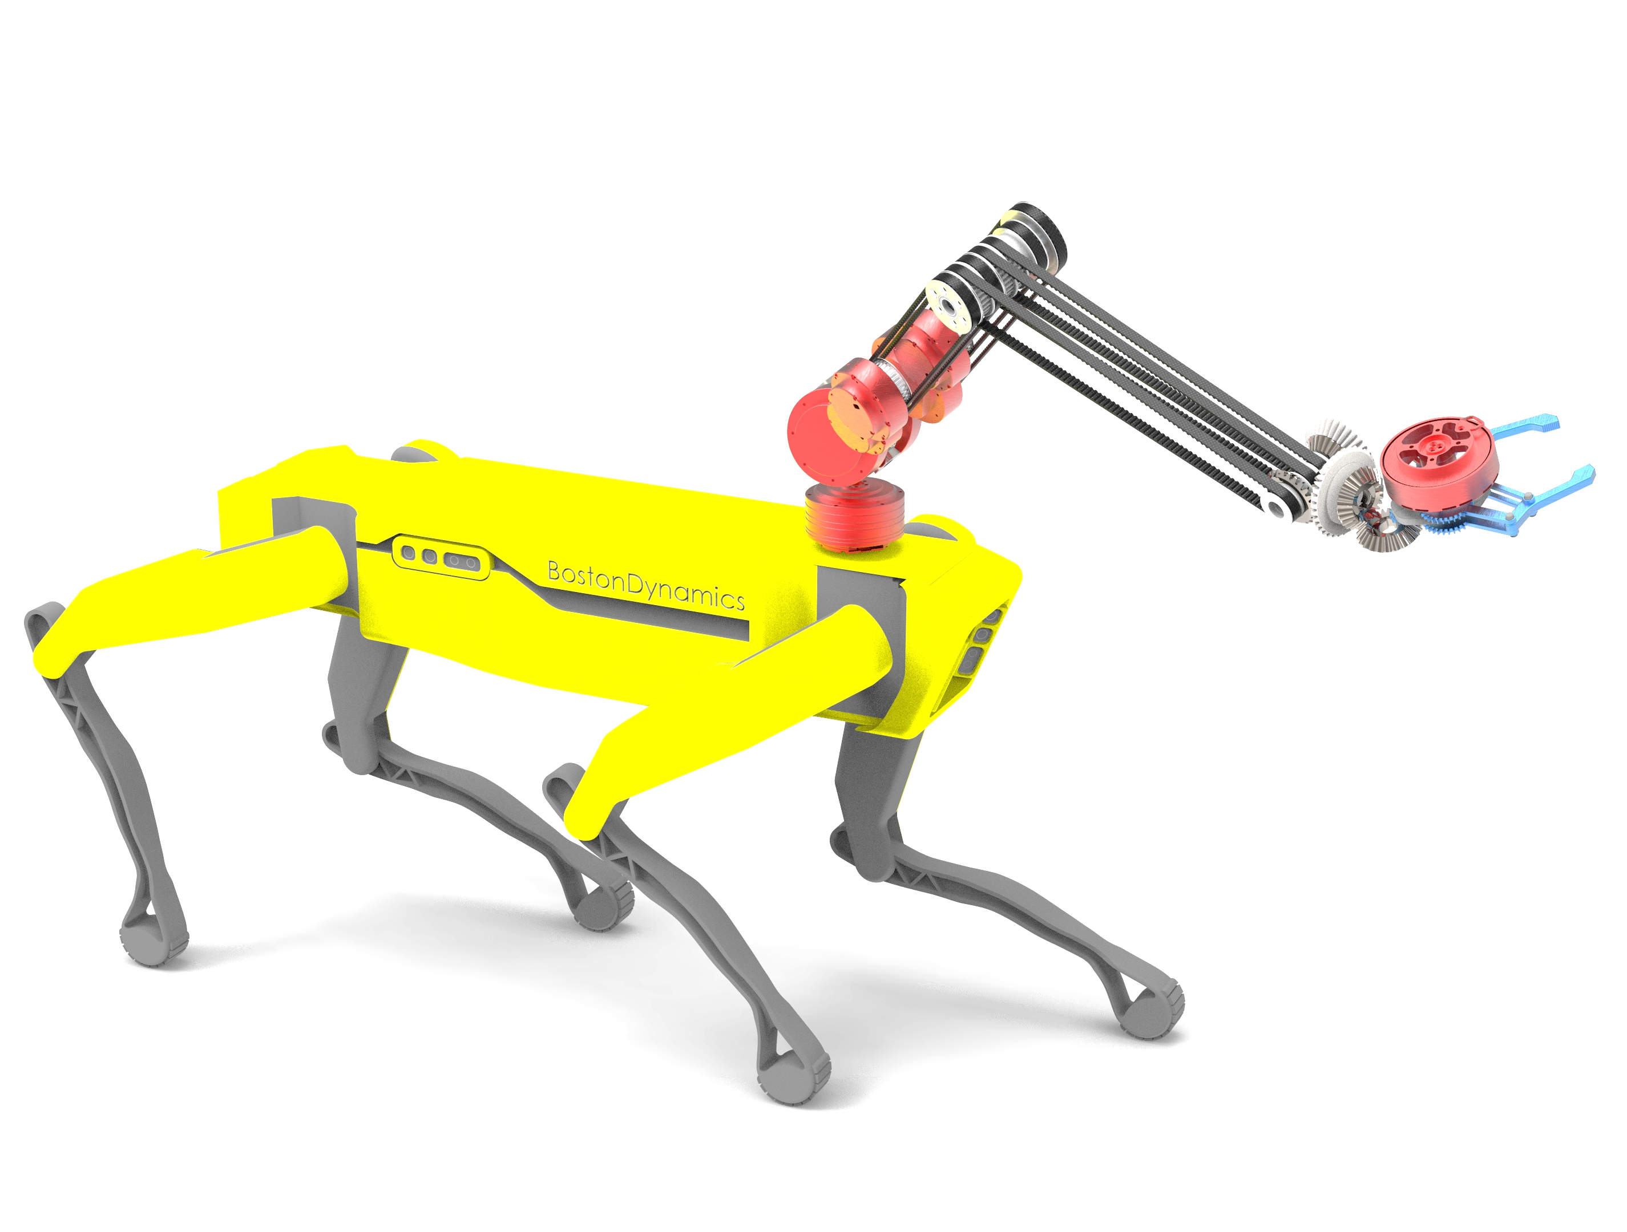

Slide 7
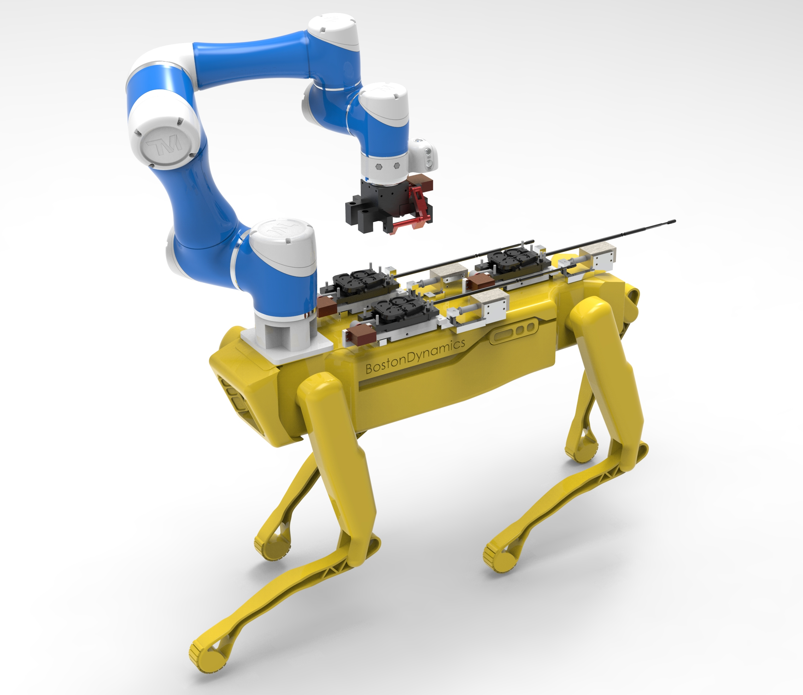

Slide 8
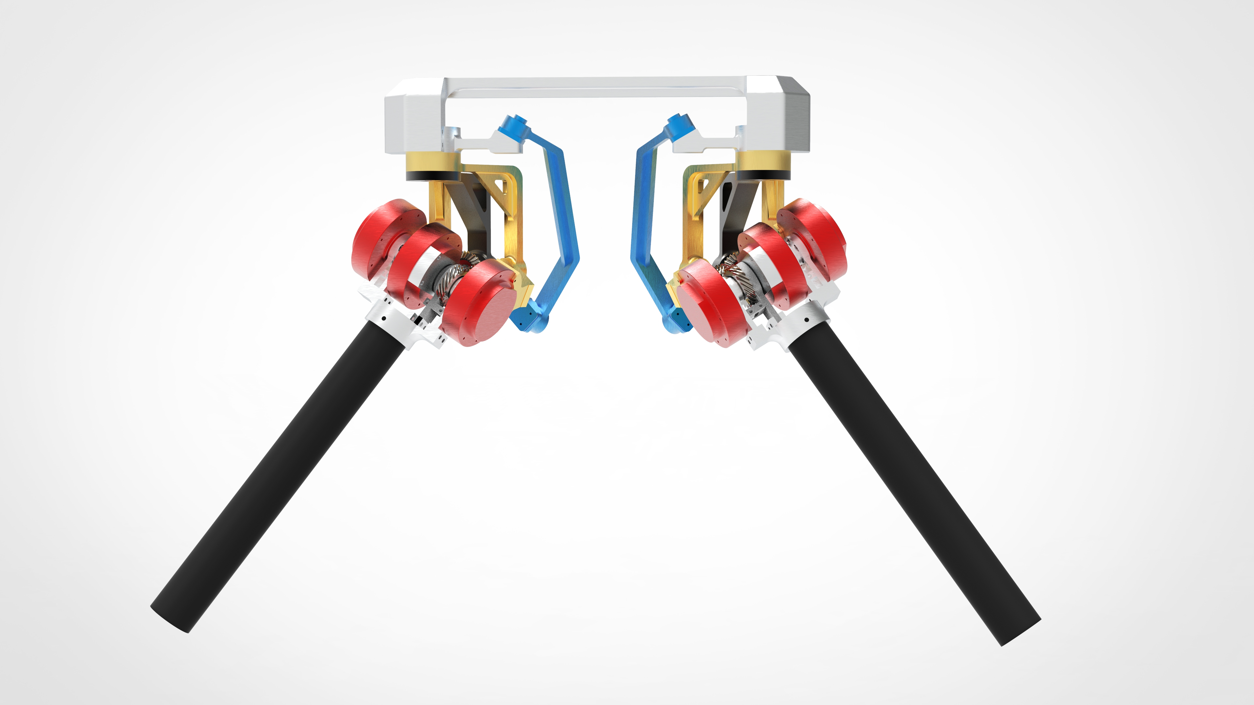
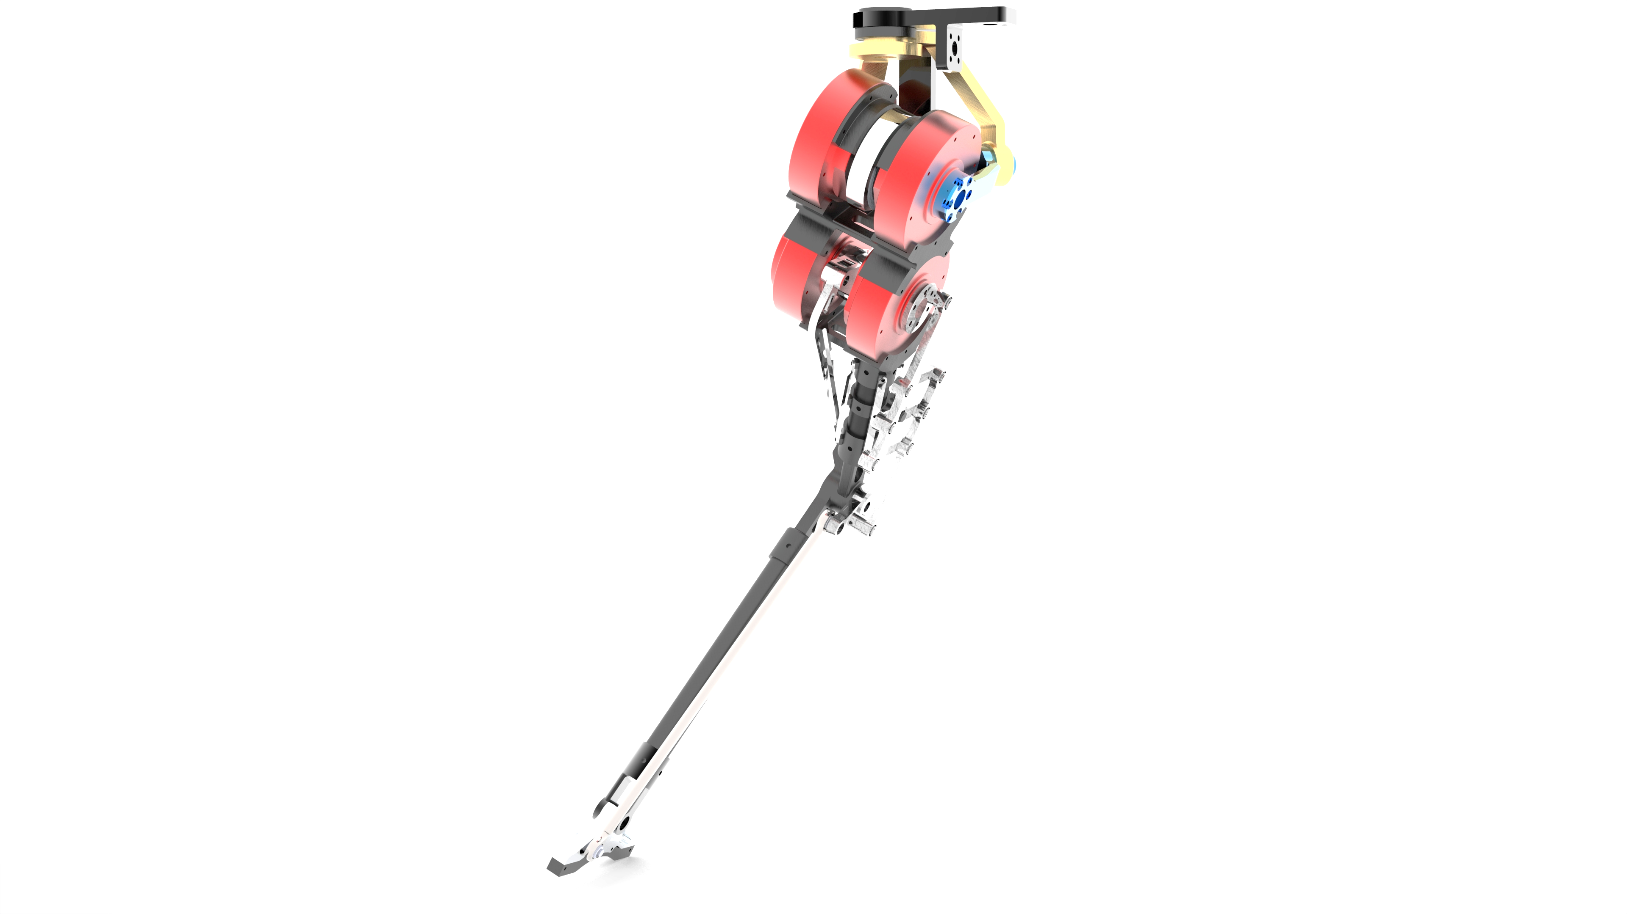
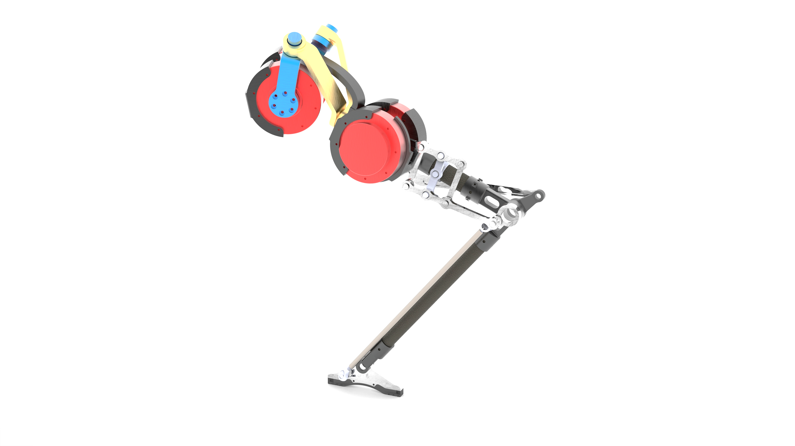
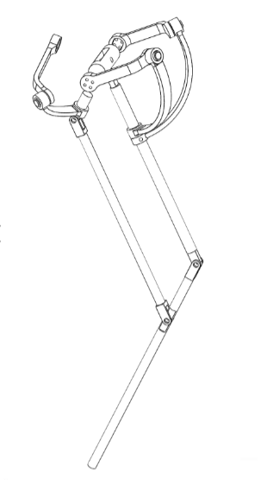

Slide 9
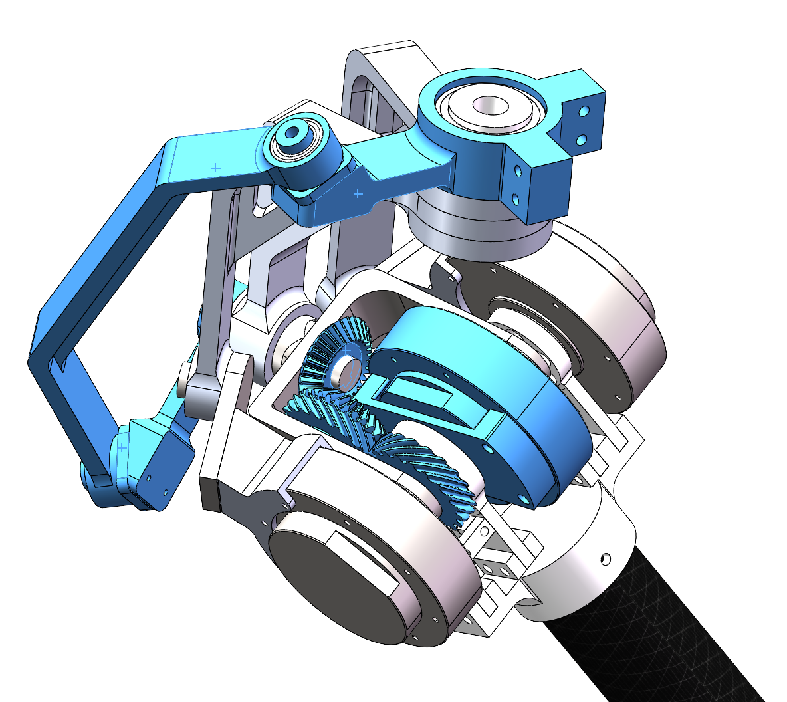
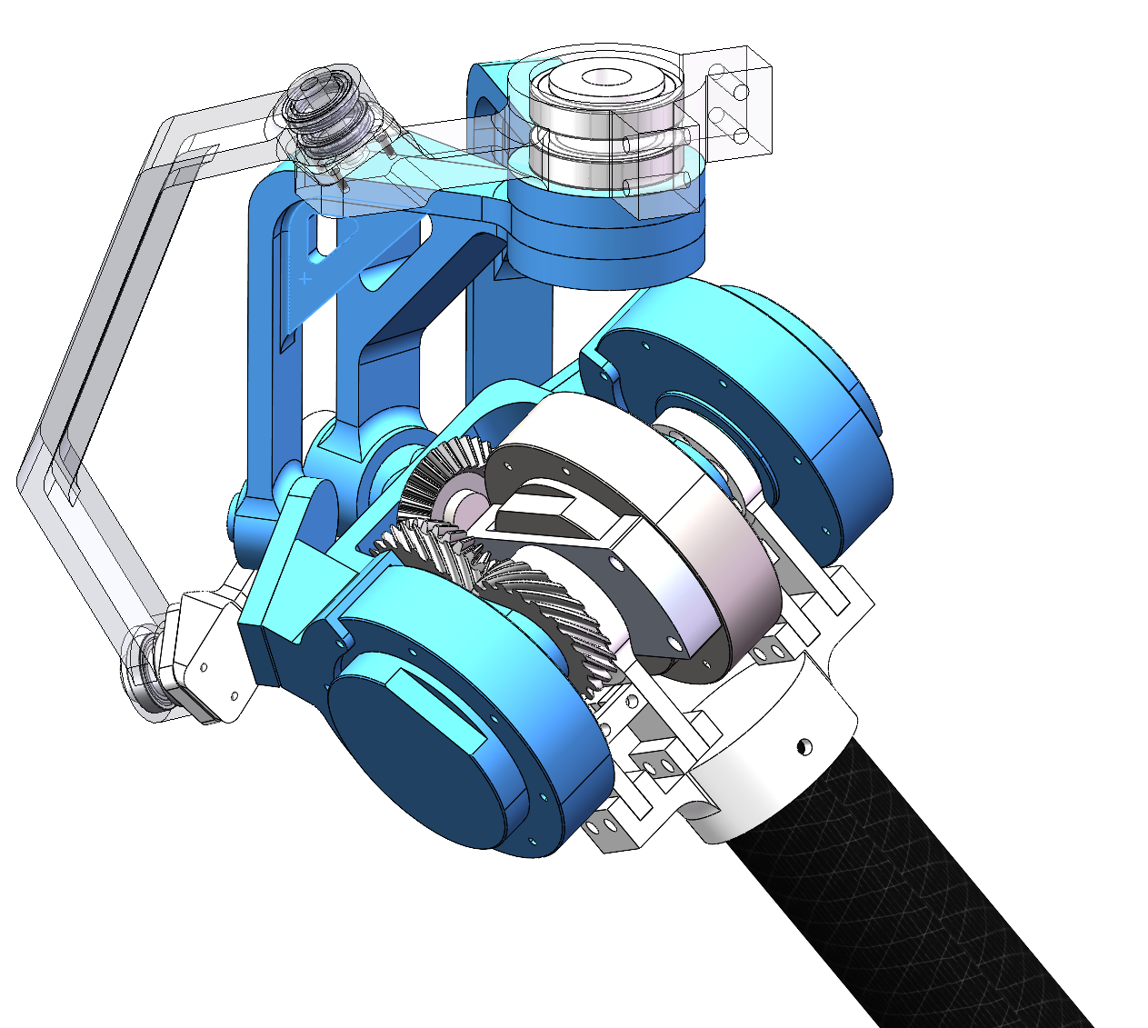
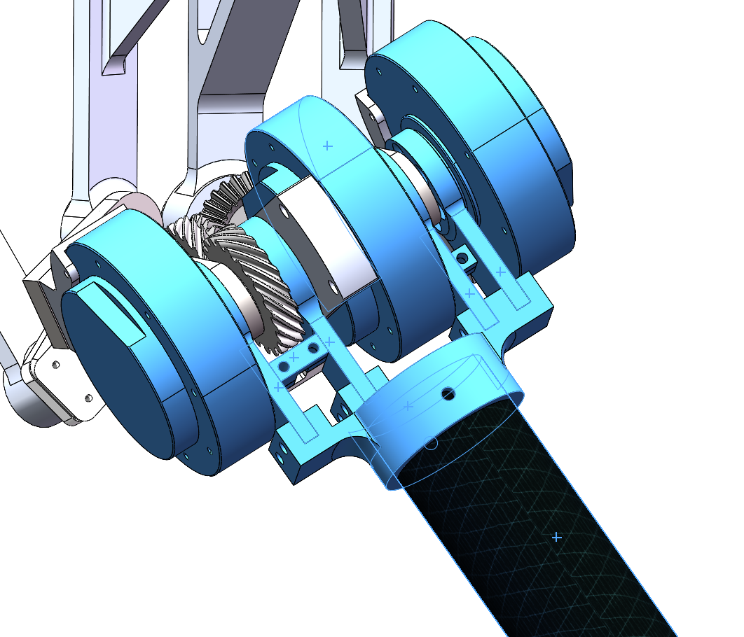
Coupled Double Differential Joint (CDD Joint)
First Differential Joint
Together Fixed Base
Abduction/Adduction DoF
2Motors: Based on SFB(spherical five bar linkage)
Yaw Motion DoF
1 Motor Control: Gear Transmission + 4-spherical-bar-linkage
Flexion/Extension DoF
3 Motors Swing together

Slide 10
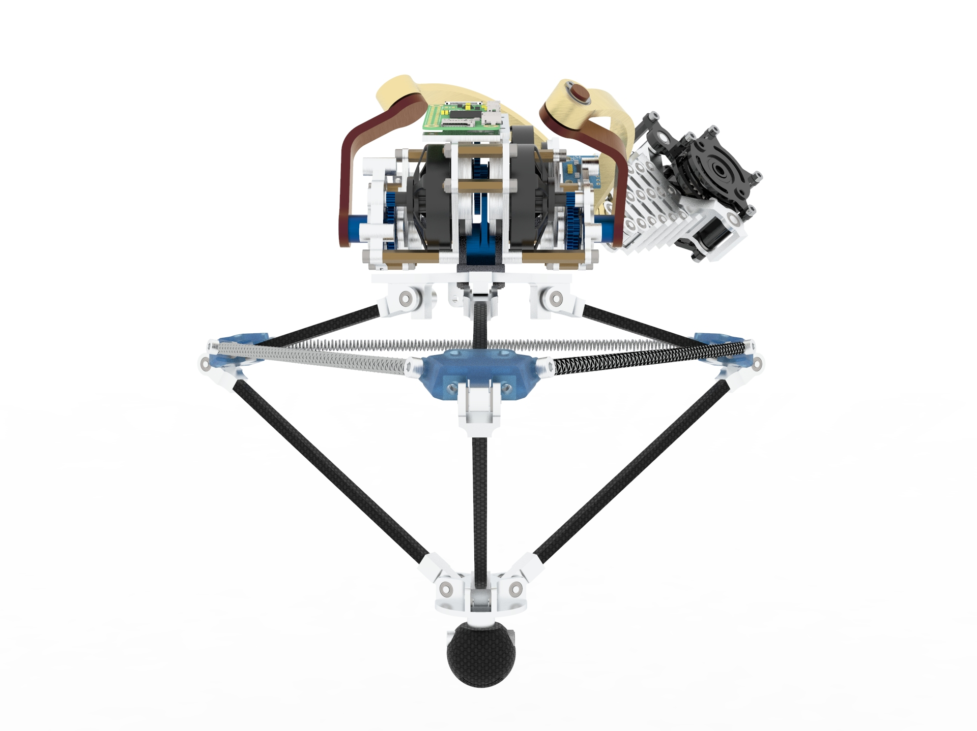

Slide 11
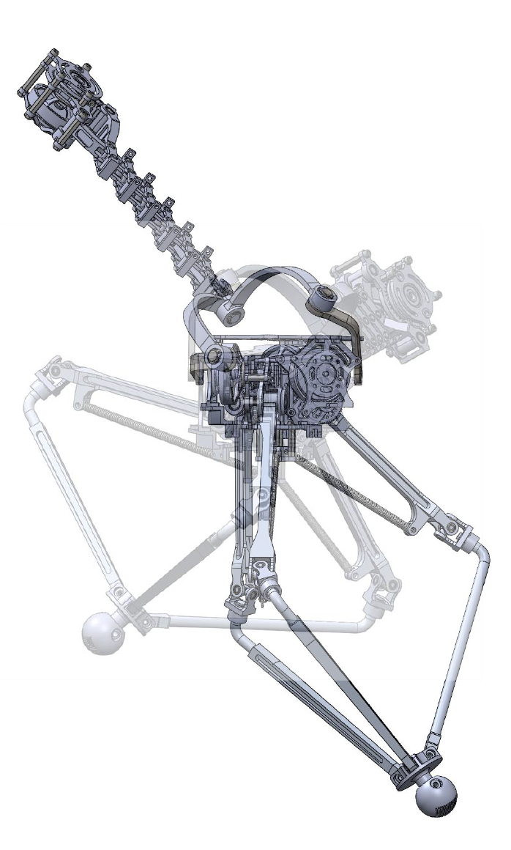
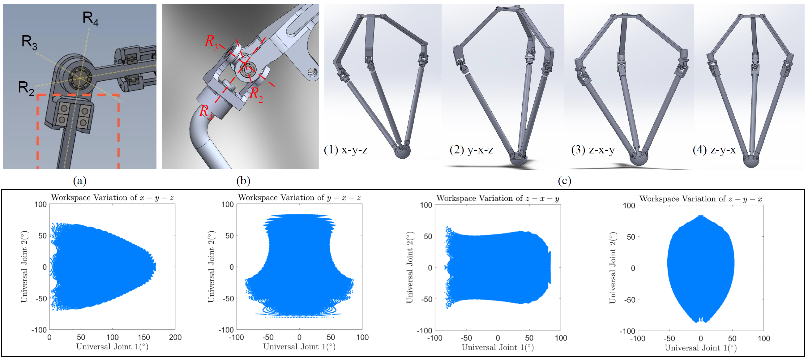
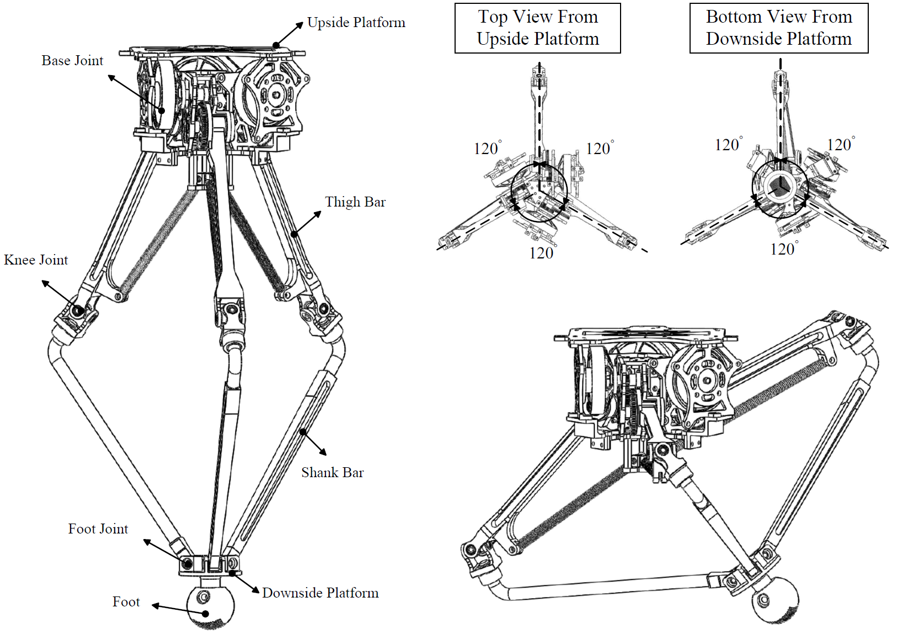
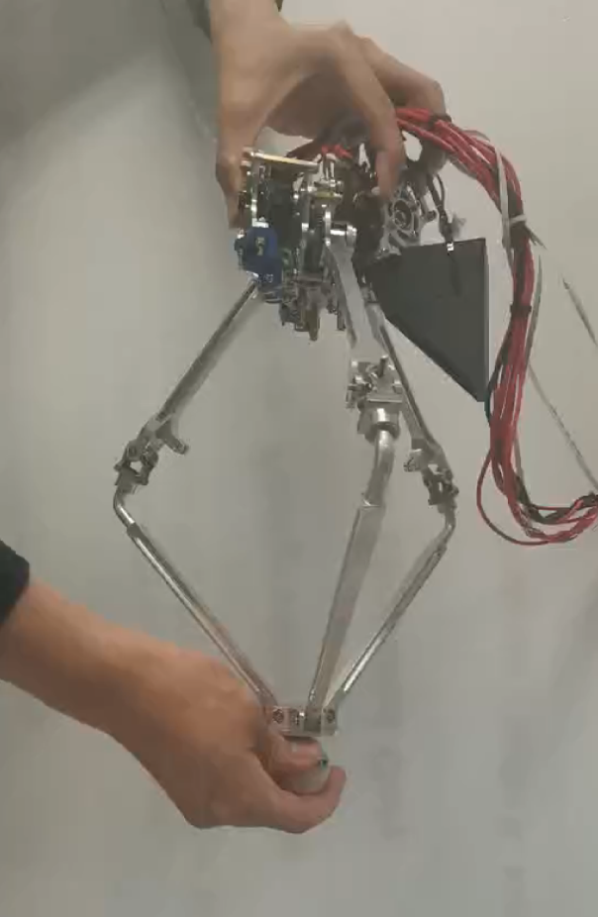
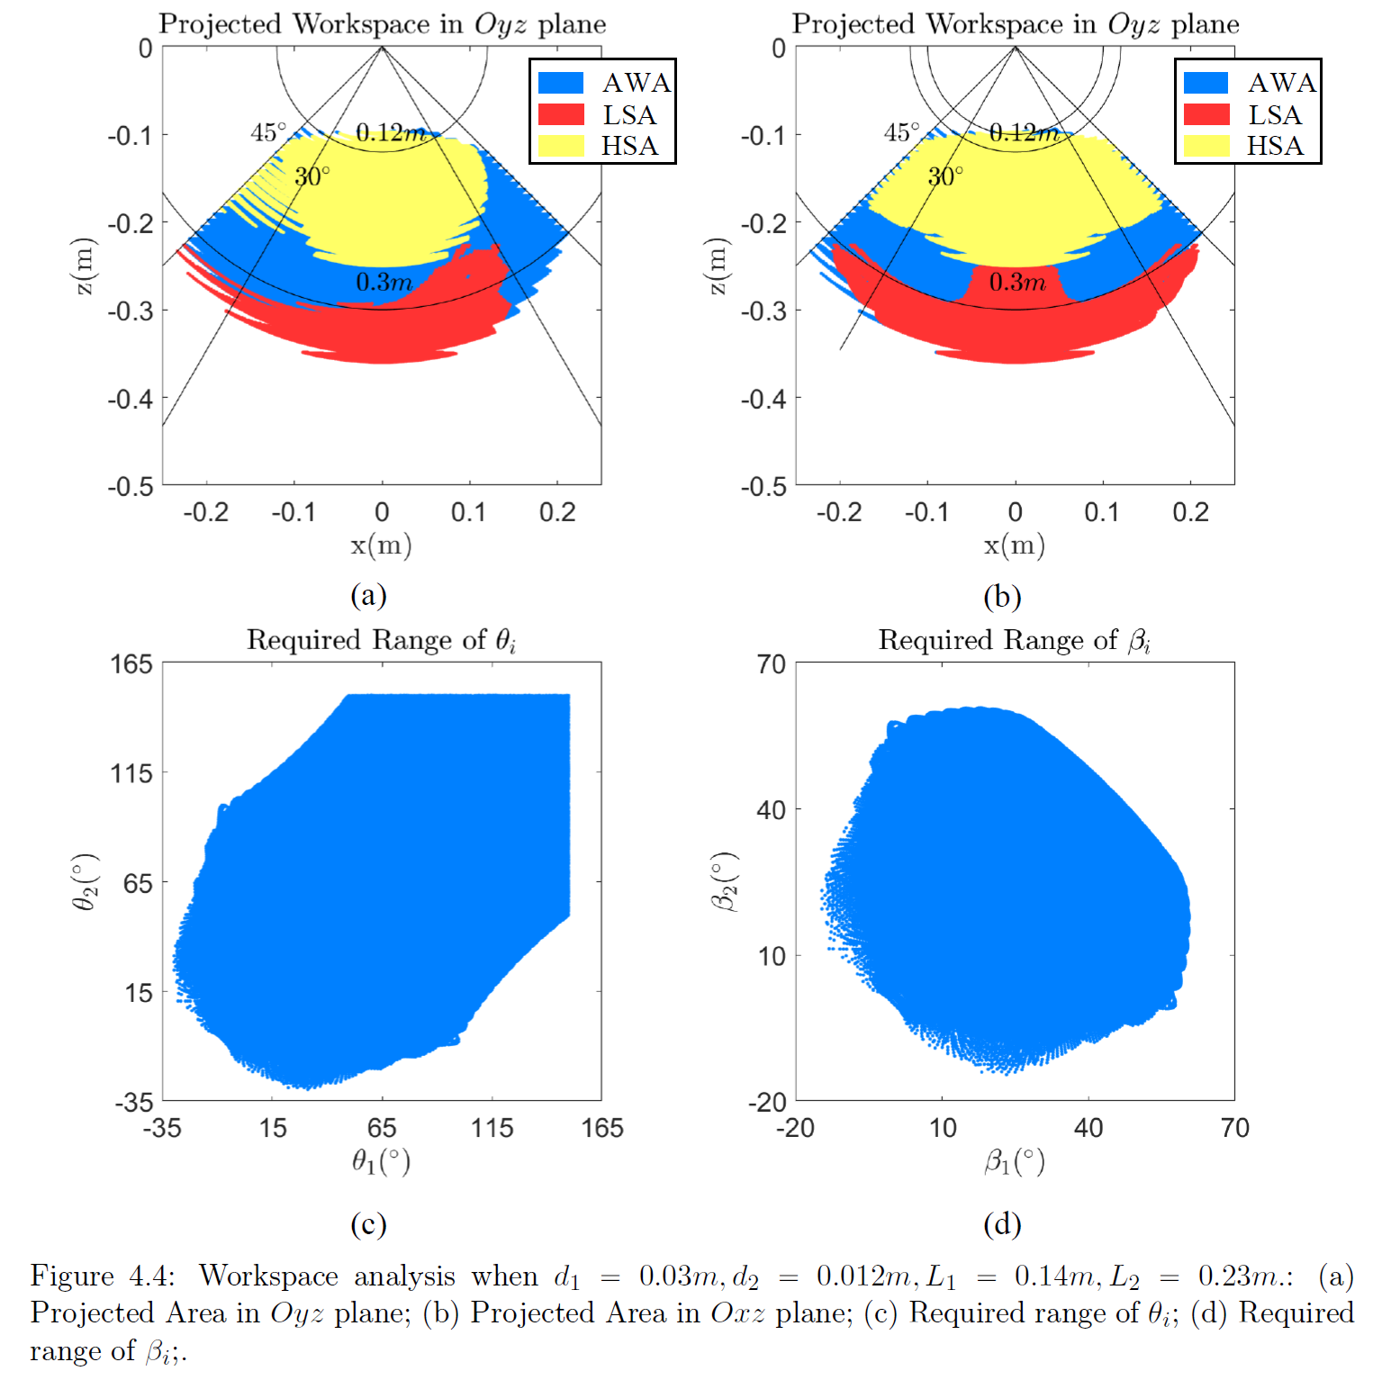
Design Overview
Joint Optimization
Leg Design
Spring Integration Analysis
Initial Prototype

Slide 12
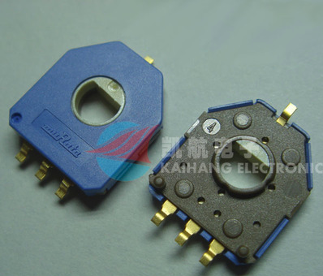
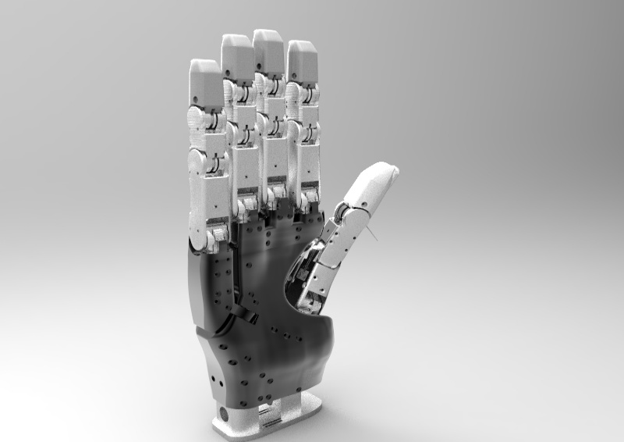
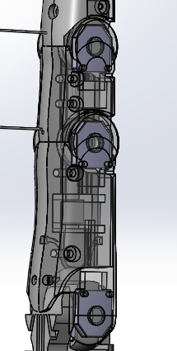
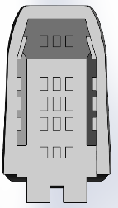
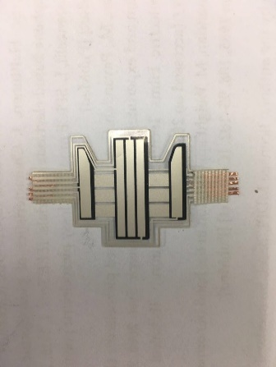
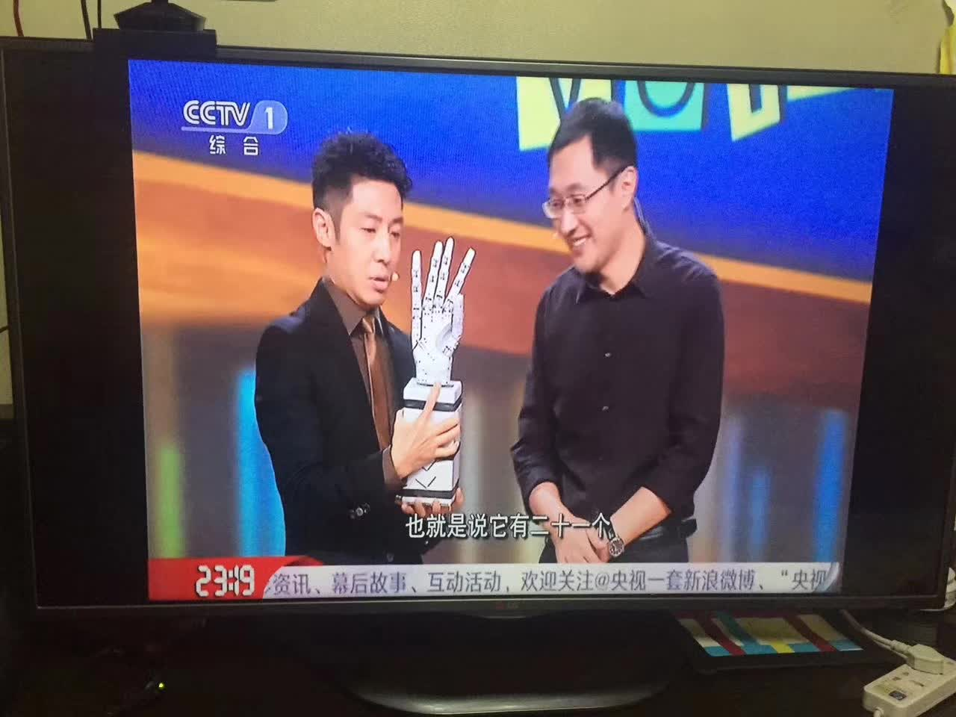
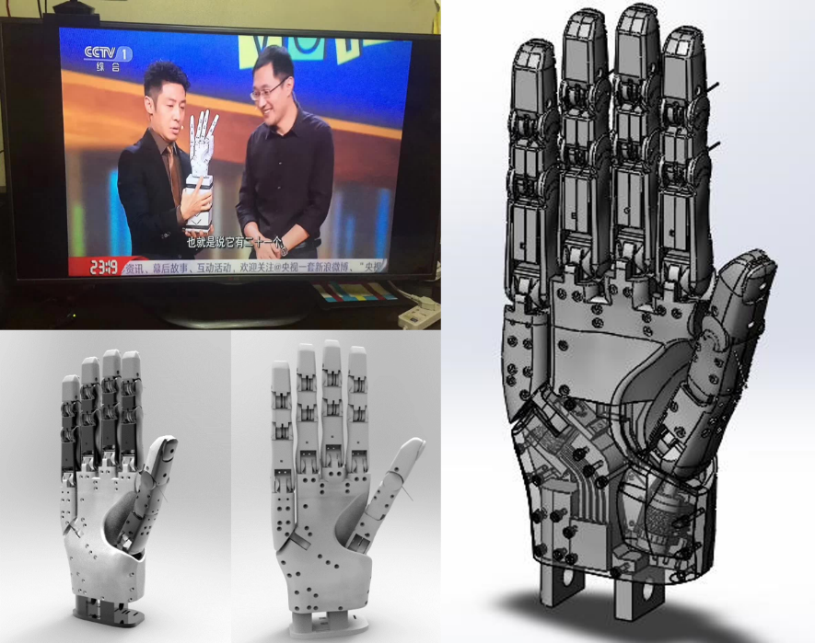
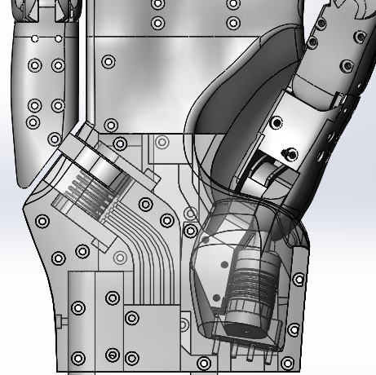
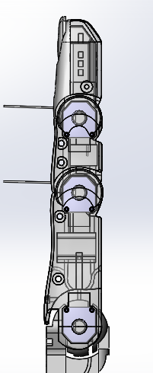
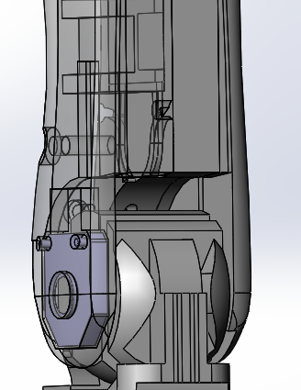
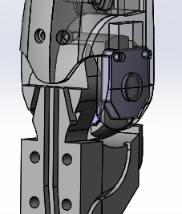
Design Overview
Sensor Integration
Prototype
Design Details

Slide 14
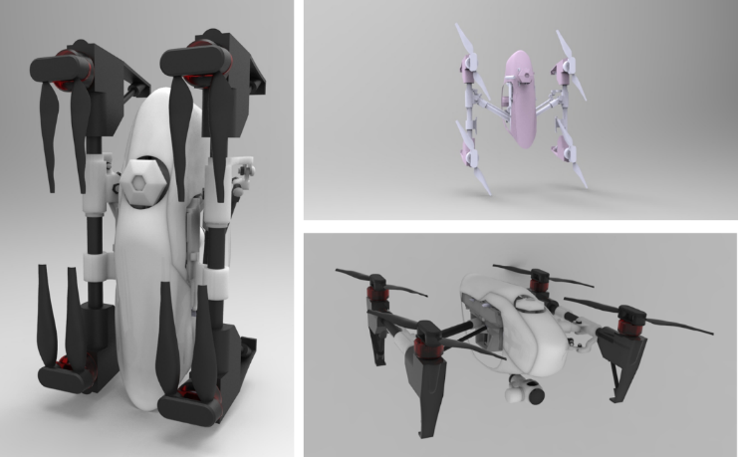

Slide 15
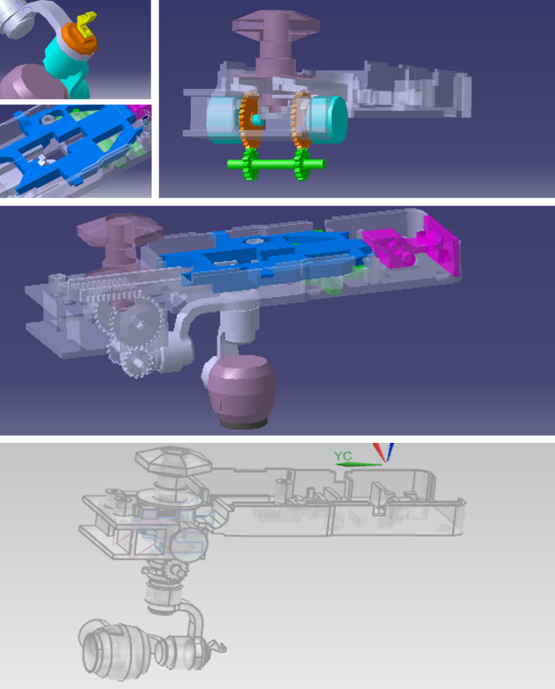
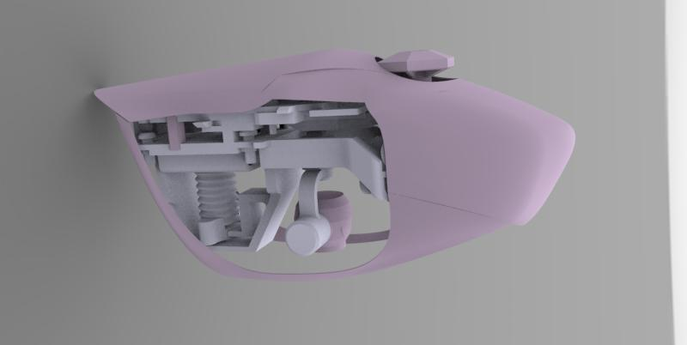
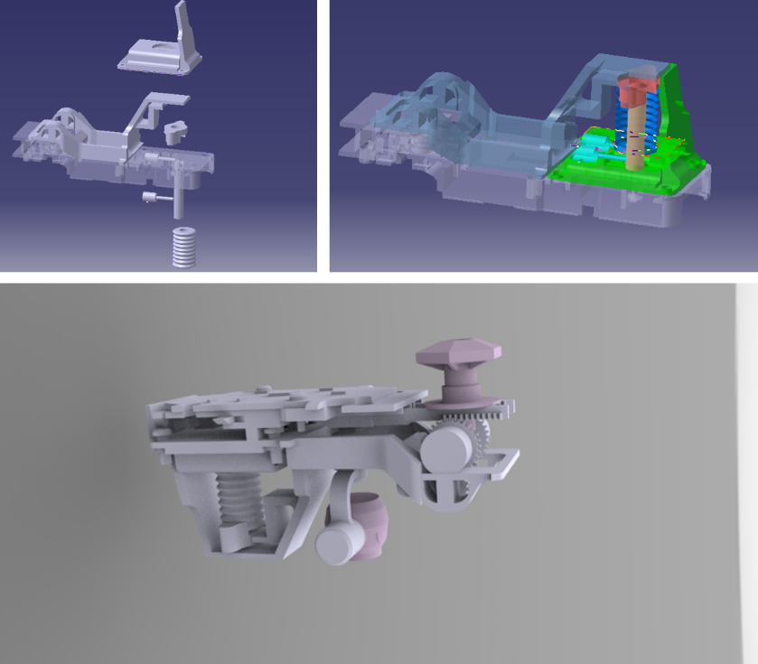
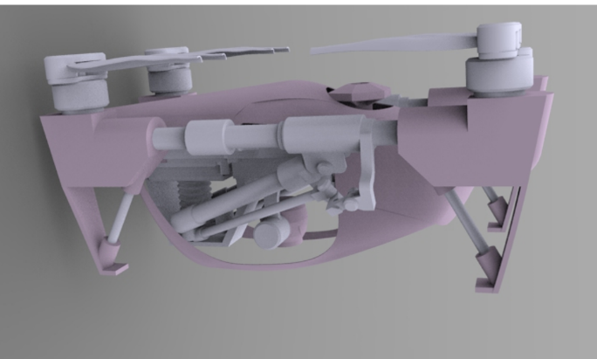
Design Overview
Design Details

Slide 16
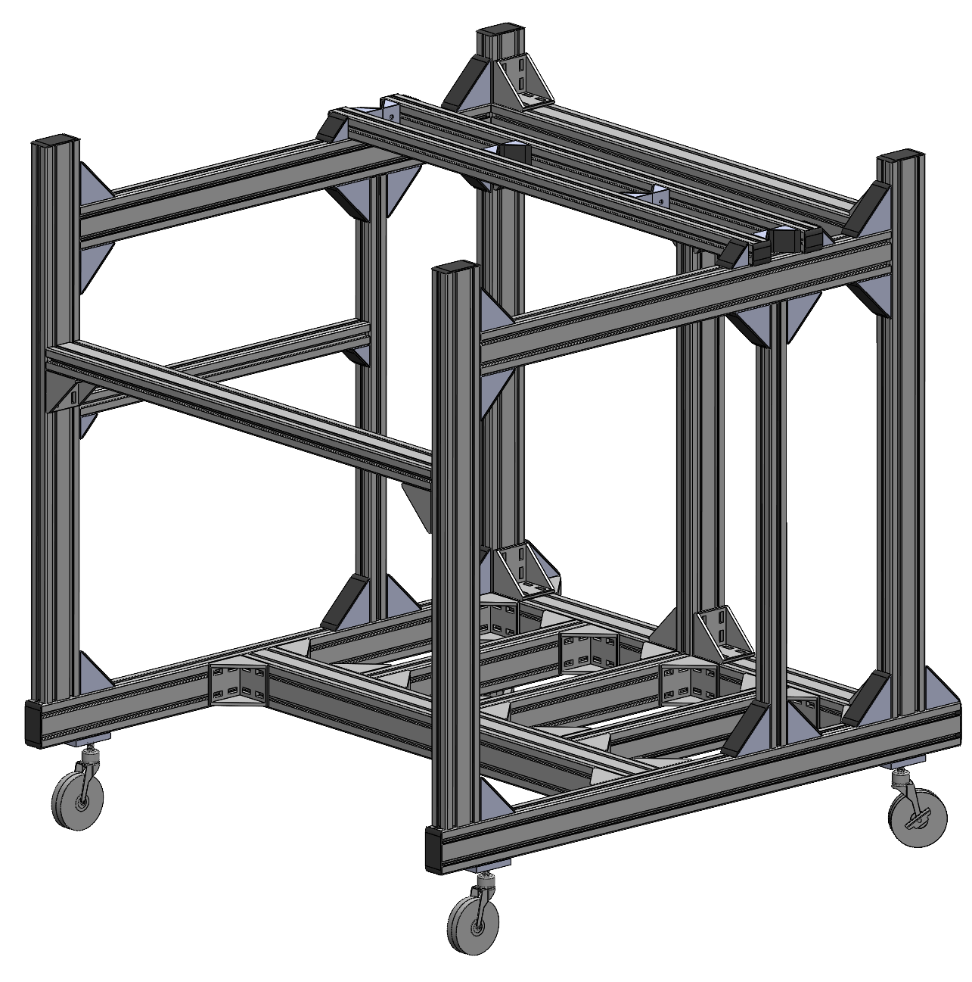
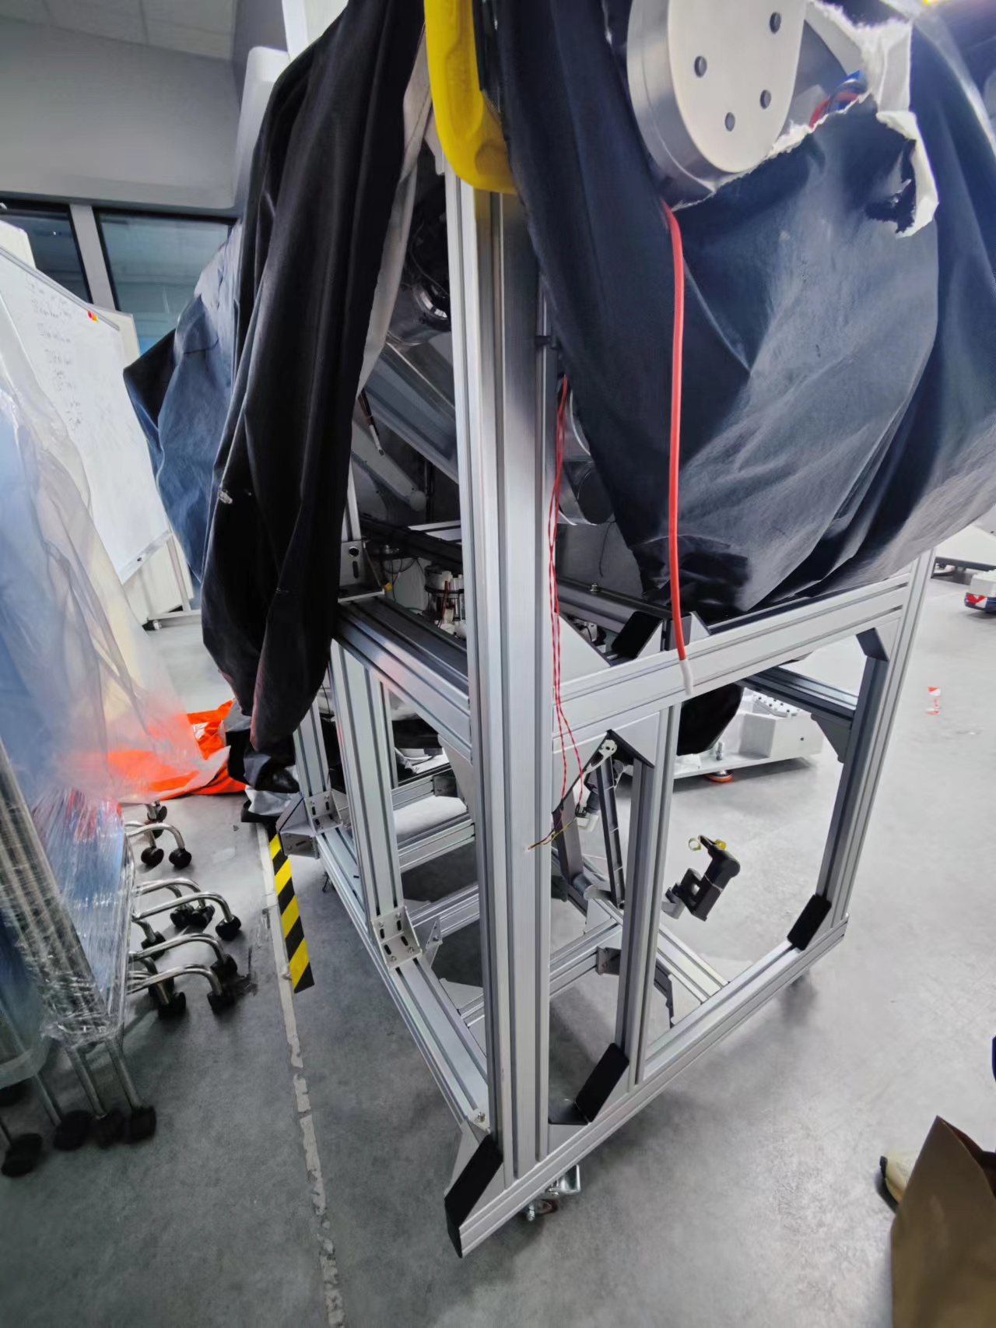
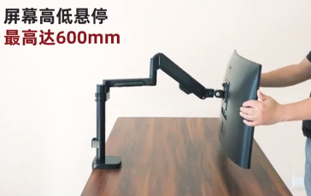
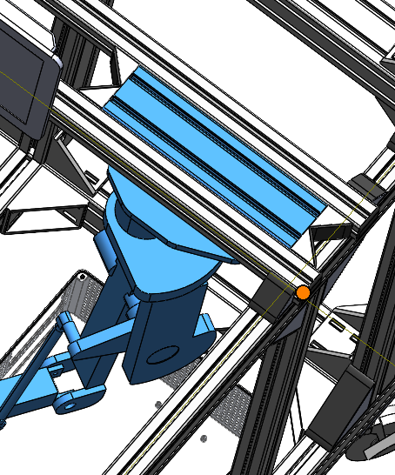
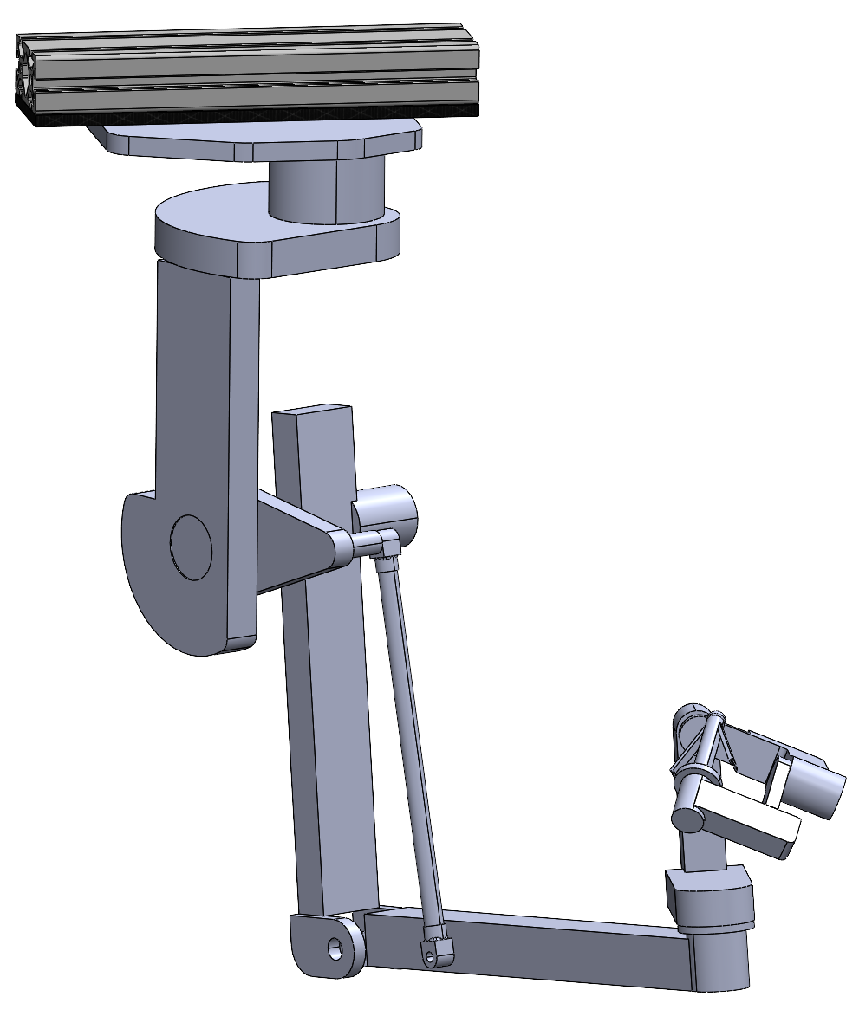
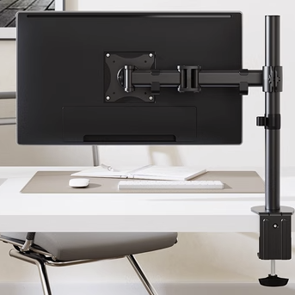




Main Body for Transporting
Connect with the framing structure for easy mounting.
Monitor Arm 1
Master Arm
Monitor Arm 2
医用万向推车轮子
(first choice)
铝型材专用福马脚轮 (backup choice, for undertaking larger forces and being more stable)
Keyboard Placer
Overview
Wheel

Slide 17

Design Overview
Prototype

Slide 18


Slide 19





Design Overview
Design Details
Tail Usages:
Balance
Adjust the walking directions
Telescopic tail can help multiple adjustment
Background
Target Motions:
Pipe or even Rope walking
Plain ground walking
Waling between 2 pipes ,walking over a hole, walking inner the pipes.

Slide 20



A
B

Slide 21






Design Overview
Design Details
A
B
Background

Slide 22


Slide 23







Design Overview
Stair Climbing
Grasping structure design
1
2
Grasping structure design
Grasping
3
4
1
2
3

Slide 24
Design Overview
Stair Climbing
Grasping structure design
1
2
Grasping structure design
Grasping
3
4
1
2
3

Slide 25



Slide 27



Robot Design
Field Introduction
Container Design
Container
Actual Field

Slide 28


Slide 29
Actual Field
Robot Components
Field Details
Robot Car

Slide 30


Slide 31
Competition Introduction
Field Object Recognition
Robot Recognition
Self Recognition

Slide 32


Slide 33


Slide 34
Competition Overview
Robot Grasping Motion
Task Operation
Visual Processing

